Slide 1
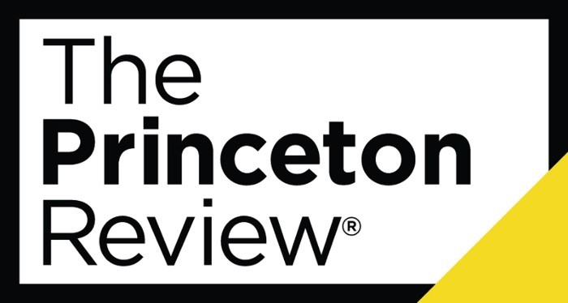
External Validation
Marist has been recognized by the Princeton Review as one of the top 50 undergraduate schools in which to study game design.
‣
Marist ranked 28th
Recognized with other institutions such as
MIT RPI NYU
Savannah College of Art and Design
The Princeton Review
recognizes Marist’s Game Design program as one of the top 50 in the country.
‣
‣
‣
‣

Slide 2

External Validation
“Marist feels just like home the moment you pull onto campus.”
Students enjoy an “enriching community” and graduate “prepared for the workplace.”
The faculty really “care about students” and “demonstrate enthusiasm for material.”
“You can receive a great education here along with the beautiful view.”

Slide 3

External Validation
“Marist’s location between NYC and Albany makes students available for internships while thoroughly involved in classes.”
Marist provides “the tools and resources of a world university and the access and personality of a small institution.”
Students say that Marist “prepares you for the professional world, with the help of great alumni.”

Slide 4
External Validation
Princeton Review’s 50 Colleges That Create Futures
Arizona State University, AZ | Princeton University, NJ
Babson College, MA | Rhodes College, TN
Bryn Mawr College, PA | Rice University, TX
CUNY – Hunter College, NY | Smith College, MA
Claremont McKenna College, CA | St. Lawrence University, NY
College of Charleston, SC | Stanford University, CA
College of William & Mary, VA | SUNY Binghamton, NY
Columbia University, NY | Stevens Institute of Technology, NJ
DePauw University, IN | Swarthmore College, PA
Drew University, NJ | University of California, San Diego, CA
Duke University, NC | University of Dayton, OH
Franklin & Marshall College, PA | University of Florida, FL
George Washington University, DC | University of Houston, TX
Gettysburg College, PA | University of Michigan – Ann Arbor, MI
Harvey Mudd College, CA | University of Notre Dame, IN
Haverford College, PA | University of Pennsylvania, PA
Hobart and William Smith Colleges, NY | University of Pittsburgh, PA
Lehigh University, PA | University of Southern California, CA
Marist College, NY | University of Texas at Austin, TX
Massachusetts Institute of Technology, MA | Vassar College, NY
Middlebury College, VT | Villanova University, PA
Northeastern University, MA | Wagner College, NY
Oberlin College, OH | Wake Forest University, NC
Pitzer College, CA | Washington University in St. Louis, MO
Pomona College, CA | Worcester Polytechnic University, MA

Slide 5
External Validation
Princeton Review’s 50 Colleges That Create Futures: 5,000 – 10,000 Students Enrolled
College of William & Mary | Stanford University
Columbia University | University of Dayton
Duke University | University of Notre Dame
Lehigh University | University of Pennsylvania
Marist College | Villanova University
Princeton University | Washington University in St. Louis

